Slide 1
Knowledge Representation & Reasoning
By Lameck Oyare

Slide 2
Contents
What is Knowledge?
Knowledge Representation Techniques
What is a knowledge Representation?
.
Requirements of Knowledge Representation
Which Knowledge Representation is Best?
Practical aspects of Good Representation
Example Systems
.
Knowledge Representation in Natural Language
References

Slide 3
What is Knowledge?
Knowledge
In order to solve the complex problems encountered in AI, one generally needs a large amount of knowledge, and suitable mechanisms for representing and manipulating all that knowledge.
Knowledge can take many forms. Some simple examples are:
John has an umbrella
It is raining
An umbrella stops you getting wet when it’s raining
An umbrella will only stop you getting wet if it is used properly
Umbrellas are not so useful when it is very windy

Slide 4
Knowledge-Based System
Knowledge base:
A set of sentences that describe the world in some formal
(representational) language (e.g. first-order logic)
Domain specific knowledge
Inference engine:
A set of procedures that work upon the representational
language and can infer new facts or answer KB queries
(e.g. resolution algorithm, forward chaining)
Domain independent

Slide 5
Types of Knowledge?
Procedural knowledge: is compiled or processed form of information.(Computer programs)
Declarative knowledge: is passive knowledge in the form of statements of facts about the world
Heuristic knowledge: are rules of thumb or tricks. Heuristic knowledge is used to make judgments and also to simplify solution of problems.
Ontological: taxonomy with relations governing concepts
Statistical: Really statements induced from data.
Taxonomic - hierarchical classification knowledge

Slide 6
What is a Knowledge Representation?
The object of a knowledge representation is to express knowledge in a computer tractable form, so that it can be used to enable our AI agents to perform well.
A knowledge representation language is defined by two aspects:
1. Syntax The syntax of a language defines which configurations of the components of the language constitute valid sentences.
2. Semantics The semantics defines which facts in the world the sentences refer to, and hence the statement about the world that each sentence makes.
This is a very general idea, and not restricted to natural language.
Suppose the language is arithmetic, then
‘x’, ‘≥’ and ‘y’ are components (or symbols or words) of the language
the syntax says that ‘x ≥ y’ is a valid sentence in the language, but ‘≥ ≥ x y’ is not
the semantics say that ‘x ≥ y’ is false if y is bigger than x, and true otherwise

Slide 7
Requirements of a Knowledge Representation
A good knowledge representation system for any particular domain should possess the following properties:
Inferential Adequacy
Representational Adequacy
the ability to manipulate the representational structures to derive new structures (corresponding to new knowledge) from existing structures.
the ability to represent all the different kinds of knowledge that might be needed in that domain.
Acquisitional Efficiency
Inferential Efficiency
the ability to acquire new information easily. Ideally the agent should be able to control its own knowledge acquisition, but direct insertion of information by a ‘knowledge engineer’ would be acceptable.
the ability to incorporate additional information into the knowledge structure which can be used to focus the attention of the inference mechanisms in the most promising directions.

Slide 8
Practical Aspects of Good Representations
In practice, the theoretical requirements for good knowledge representations can usually be achieved by dealing appropriately with a number of practical requirements:
The representations need to be complete – so that everything that could possibly need to be represented, can easily be represented.
They must be computable – implementable with standard computing procedures.
They should make the important objects and relations explicit and accessible – so that it is easy to see what is going on, and how the various components interact.
They should suppress irrelevant detail – so that rarely used details don’t introduce unnecessary complications, but are still available when needed.
They should expose any natural constraints – so that it is easy to express how one object or relation influences another.
They should be transparent – so you can easily understand what is being said.
The implementation needs to be concise and fast – so that information can be
stored, retrieved and manipulated rapidly.

Slide 9
Components of a Good Representation
For analysis purposes it is useful to be able to break any knowledge representation down into their four fundamental components:
1. The lexical part – that determines which symbols or words are used in the representation’s vocabulary.
2. The structural or syntactic part – that describes the constraints on how the symbols can be arranged, i.e. a grammar.
3. The semantic part – that establishes a way of associating real world meanings with the representations.
4. The procedural part – that specifies the access procedures that enables ways of creating and modifying representations and answering questions using them,
i.e. how we generate and compute things with the representation.
In the following we shall look at these in more detail for some specific examples.

Slide 10
Uses of knowledge
Learning
acquiring knowledge. This is more than simply adding new facts to a knowledge base. New data may have to be classified prior to storage for easy retrieval, etc.. Interaction and inference with existing facts to avoid redundancy and replication in the knowledge and and also so that facts can be updated.
Retrieval
The representation scheme used can have a critical effect on the efficiency of the method. Humans are very good at it.
Many AI methods have tried to model humans

Slide 11
Uses of knowledge (2)
Reasoning
Infer facts from existing data.
If a system only knows: Daisy is a world class model. All world class models are beautiful.
If things like Is Daisy a world class model? or Are world class models beautiful? are asked then the answer is readily obtained from the data structures and procedures. However a question like Is Daisy beautiful? requires reasoning.

Slide 12
Knowledge Representation in Natural Language
Humans usually use natural language (English, Spanish, Chinese, etc.) to represent knowledge, so why not use that to represent knowledge in our AI systems?
Advantages of Natural Language
1. It is extremely expressive – we can express virtually everything in natural language (real world situations, pictures, symbols, ideas, emotions, reasoning, …).
2. Most humans use it most of the time as their knowledge representation of choice (how many text books are not written in natural language?).
Disadvantages
1. Both the syntax and semantics are very complex and not fully understood
2. There is little uniformity in the structure of sentences.
3. It is often ambiguous – in fact, it is usually ambiguous.

Slide 13
Database Systems
Simple databases are commonly used to good effect in Computer Science. They can be use to store and manipulate virtually any kind of information.
For example, the database may consist of a number of simple records stored in ASCII format:
Person record = { name : max 32 characters
age : 3 digits in range 000-127
sex : male or female
marital status : single, engaged, married, divorced, widowed
employer : company code of 3 characters
children’s names : up to 8 names each with max 16 characters
}
Generally, the records can have any number of fields, containing whatever information we need, in any format, together with any appropriate links between them.

Slide 14
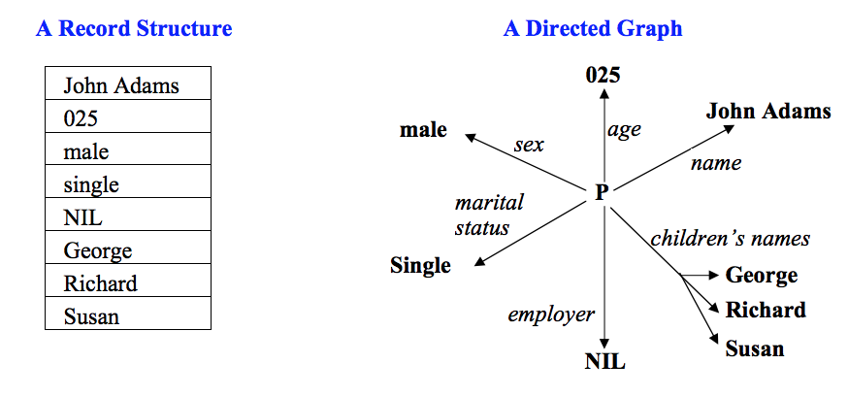
Instances in a Database System
Information in a database can be displayed in a variety of ways, for example

Slide 15
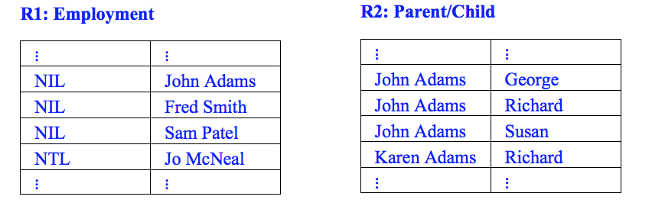
Manipulations of a Database System
We can construct sentences in an appropriate language, for example:
“marital_status(John Adams) is single” CORRECT
“marital_status(John Adams) is divorced” INCORRECT SEMANTICS
“marital_status(025) is male” INCORRECT SYNTAX
We can also generate relations, for example:

Slide 16
Databases as a Knowledge Representation
Traditional database systems are clearly very powerful, but for AI systems they are rather limited. The important issues are:
Advantages
1. Databases are well suited to efficiently representing and processing large amounts of data (and derivation from a database is virtually independent of its size).
2. We can build on traditional database systems to process more complex and more powerful representational devices (e.g. frames).
Disadvantages
1. Only simple aspects of the problem domain can be accommodated.
2. We can represent entities, and relationships between entities, but not much more.
3. Reasoning is very simple – basically the only reasoning possible is simple lookup, and we usually need more sophisticated processing than that.

Slide 17
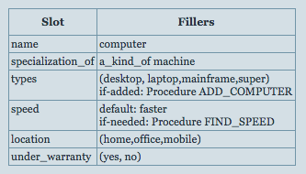
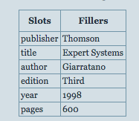
Frame Based Systems
A frame is similar to a record structure and corresponding to the fields and values are slots and slot fillers. Frame systems usually have collection of frames connected to each other. Value of an attribute of one frame may be another frame.
Simple example generic example
Generally a whole hierarchy of frames is used to represent the required domain. It is often helpful to represent the structure of that hierarchy as a Semantic Network.

Slide 18
Characteristics and Problem with Frames
What can we represent with frames?
Properties of entities
A generic is a hierarchy
Problems with frames
No procedural description
The is a hierarchy is used both for specialization and instances

Slide 19
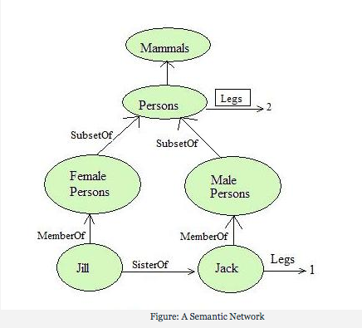
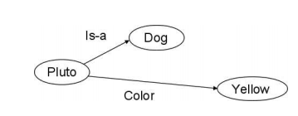
Semantic Networks
is a knowledge representation technique used for propositional information. They are two dimensional representations of knowledge. Semantic nets consist of nodes, links (edges) and link labels.

Slide 20
Semantic Networks
Advantages
They convey some meaning in a transparent manner.
They nets are simple and easy to understand.
They are easy to translate into PROLOG.
Node objects represented only once.
Related knowledge is easily categorised.
Disadvantages
No representation of semantics of links
No classification of nodes
No procedural description

Slide 21
Logic Representation
Logic is a formal system in which the formulas or sentences have true or false values
A logic includes:
Syntax: Specifies the symbols in the language and how they can be combined to form sentences. Hence facts about the world are represented as sentences in logic
Semantics: Specifies what facts in the world, a sentence refers to. Hence, also specifies how you assign a truth value to a sentence based on its meaning in the world. A fact is a claim about the world, and may be true or false.
Inference Procedure: Mechanical method for computing (deriving) new (true) sentences from existing sentences

Slide 22
Representation, Reasoning, and Logic
The objective of knowledge representation is to express knowledge in a computer-tractable form, so that agents can perform well.
A representation that has clear syntax and semantics is a logic representation
Logics include:
Propositional logic
Predicate logic (FOPC)
HOPC
Fuzzy Logic
Temporal logic
Description Logics

Slide 23
Propositional Logic
Propositional Logic is the logic of compound statements built from simpler statements using so-called Boolean connectives.
Logics include:
Some applications in computer science:
Design of digital electronic circuits.
Expressing conditions in programs.
Queries to databases & search engines.

Slide 24
Definition of a Proposition
A proposition is simply: a statement (i.e., a declarative sentence)
with some definite meaning, (not vague or ambiguous) having a truth value that’s either true (T) or false (F)
Logical constants: true, false
Propositional symbols: P, Q, S, ... (atomic sentences)
Wrapping parentheses: ( … )
Sentences are combined by connectives:
 ...and [conjunction]
 ...or [disjunction]
...implies [implication / conditional]
..is equivalent [biconditional]
➢ ...not [negation]
Literal: atomic sentence or negated atomic sentence

Slide 25
Propositional Logic (PL): Semantics
Need an interpretation of symbols for a given set of sentences
Proposition symbols do not have meaning by themselves
An interpretation connects proposition symbols to a statement about the world (which may be true or false in that world)
An interpretation in PL can be defined as an assignment of truth values to all proposition symbols involved
There are many interpretations for a given set of sentences (2^n if they involve n distinct proposition symbols)
Example: Use truth tables to provide semantics
Give a meaning to each logical connectives
Provide semantics

Slide 26
Weakness of PL
Hard to identify "individuals." E.g., Mary, 3
Individuals cannot be PL sentences themselves.
Difficult to directly and clearly talk about properties of individuals or relations between individuals (hard to connect individuals to class properties).
E.g., property of being a human implies property of being mortal
Generalizations, patterns, regularities can't easily be represented.
All members of a class have this property
Some member of a class have this property

Slide 27

First Order Logic
Logic is the formal systematic study of the principles of valid inference and correct reasoning. Logic is often divided into two parts, inductive reasoning and deductive reasoning.
Some typical sentences in first order logic are:
1. man(William) ∨ woman(Susan)
2. married(William, Susan)
3. ∀x∃y[person(x) ⇒ has_mother(x,y)]
4. ∀x∀y[[parents(x,y) ∧ man(x)] ⇒ ¬man(y)
The language consists of constants {William, Susan, etc.}, variables {x, y, etc.},functions/predicates {Married(x,y), person(x), etc.}, and the logic symbols:

Slide 28
First Order Logic as a Knowledge Representation
We can combine sentences by the ‘rules of logic’ to produce new sentences, e.g.
¬man(Chris)
¬man(x) ⇒ woman(x)
woman(Chris)
As a knowledge representation, first order logic has pros and cons:
Advantages
1. It is very expressive.
2. It has unambiguous syntax and semantics.
Disadvantage
1. There is no generally efficient procedure for processing knowledge.

Slide 29
Databases as a Knowledge Representation
Traditional database systems are clearly very powerful, but for AI systems they are rather limited. The important issues are:
Advantages
1. Databases are well suited to efficiently representing and processing large amounts of data (and derivation from a database is virtually independent of its size).
2. We can build on traditional database systems to process more complex and more powerful representational devices (e.g. frames).
Disadvantages
1. Only simple aspects of the problem domain can be accommodated.
2. We can represent entities, and relationships between entities, but not much more.
3. Reasoning is very simple – basically the only reasoning possible is simple lookup, and we usually need more sophisticated processing than that.

Slide 30
Rule Based Systems
A rule based system consists of:
1. A database management system for handling the domain specific facts.
2. A rule set for representing the knowledge structure/relations.
3. A rule interpreter to carry out the problem solving.
A typical rule set might be:
R1. IF Raining ∧ Outside(x) ∧ HasUmbrella(x) THEN UseUmbrella(x)
R2. IF Raining ∧ Outside(x) ∧ ¬HasUmbrella(x) THEN GetWet(x)
R3. IF GetsWet(x) THEN CatchCold(x)
R4. IF Sunny ∧ Outside(x) THEN GetSunBurnt(x)
It should be easy enough to set up an appropriate database management system.

Slide 31
Rule based Inference
If we have a knowledge base consisting of facts and rules, and a rule interpreter to match the rule conditions against the facts, and a means for extracting the rules, then we can derive new knowledge. For example, using the above rule set:
Suppose we have three initial facts: Raining, Outside(John), ¬HasUmbrella(John).
Then only the rule R2 with ‘x = John’ matches the facts, so we are able to infer
GetsWet(John). This means we now have four facts in our knowledge base: Raining,
Outside(John), ¬HasUmbrella(John), GetsWet(John).
Then R3 with ‘x = John’ matches the facts, so we can also infer CatchesCold(John),
and end up with five facts: the initial three, GetsWet(John), CatchesCold(John).
Note that there is no way we can end up with GetsSunTan(John).
The process of deriving new facts from given facts is called inference.

Slide 32
Rule Based Systems as a Knowledge Representation
Advantages
1. These systems are very expressive.
2. The rules lead to a degree of modularity.
3. We can easily introduce procedures for handling certainty factors, and this leads to the possibility of probabilistic reasoning.
Disadvantage
1. There is a lack of precise semantics for the rules.
2. The systems are not always efficient.

Slide 33
Production Rules
Two types of production rules exist:
Inference-type production rule
Both antecedents and consequents are assertions about data in STM.
Situation action rules
Antecedent is a logical combination of assertions about the data in STM and consequent is a collection of actions that change STM.

Slide 34
Production Rules (2)
The term rule in AI, which is the most commonly used type of knowledge representation, can be defined as an IF-THEN structure that relates given information or facts in the IF part to some action in the THEN part.
A rule provides some description of how to solve a problem. Rules are relatively easy to create and understand.
Any rule consists of two parts:
the IF part, called the antecedent (premise or condition)
and the THEN part called the consequent (conclusion or action).
A rule can have multiple antecedents joined by the keywords AND (conjunction), OR (disjunction) or a combination of both

Slide 35
Production Rules (3)
Rules can represent relations, recommendations, directives, strategies and heuristics:
Relation
IF the ‘fuel tank’ is empty THEN the car is dead
Recommendation
IF the season is autumn AND the sky is cloudy AND the forecast is drizzle THEN the advice is ‘take an umbrella’
Directive
IF the car is dead AND the ‘fuel tank’ is empty
THEN the action is ‘refuel the car’

Slide 36
Reasoning with Production Rules
Production systems used as the basis for many rule-based expert systems
Reasoning in:
forward (situation-action rules) or
backward chaining (situation-action and inference rules)

Slide 37
Which Knowledge Representation is Best?
one needs to consider exactly;
what has to be represented
how that knowledge needs to be processed.
In practice, there is no single best knowledge representation system that can be used for everything. In building large complex AI systems, one will usually want to employ many different types of knowledge representation. So we shall study many…

Slide 38
Example Systems
Cognitive Assistant (SIRI)
What knowledge must it represent?
Restaurants, movies, events, reviews, …
Location, tasks, web sources, …
Computational Knowledge Engine (Wolfram Alpha)
Smart Textbook (Inquire)
What knowledge must it represent? Concepts, definitions, relationships, descriptions
What reasoning must it do?
Follow relationships, answer questions
What knowledge must it represent?
Different kinds of foods, their nutrition composition, caloric values
Reasoning:
Mathematical computations based on portions

Slide 39
Reading/References
1
Artificial Intelligence third Edition: Rich & Knight
2
Artificial Intelligence Modern approach: Russell & Norvig
3
Knowledge Representation and Reasoning: Ronald j. Brachman
4
Chapter 1 of Brachman & Levesque textbook

Slide 40
Thank you

